Slide 1
Snake & Ladder Game
Project Members-
Sudip Padhye (2KE12CS054)
Chandrashekar Meenakeri (2KE13CS403)
Guides-
Prof.Kiran Malagi
Prof.Vijayamahantesh Kanvi

Slide 2

Snake & Ladder Game
Introduction-
A good entertaining game among children
Purely based on luck
Consists 10 x 10 matrix embedded with snakes and ladders
Players - Most Snakes and Ladders games require at least two people to take part.
Objective - The objective of most Snakes and Ladders games is to be the first player to get their game piece to the end of the board.

Slide 3
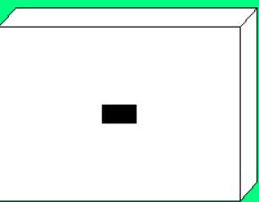
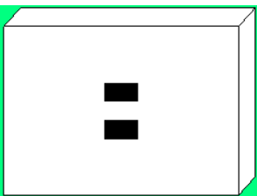
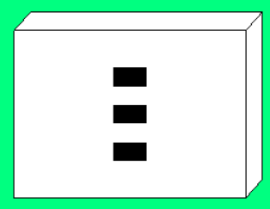
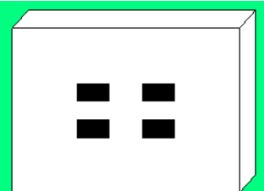
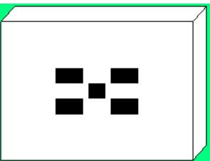
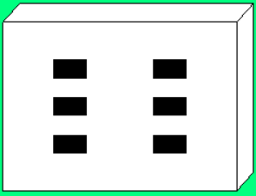
Implementation
Basically, the game is proceeded with the number on the top face of the die.
For this purpose, we use rand( ) and srand( ) functions.
This number is then passed to user defined dice( ) function to display that many no. of dots.

Slide 4
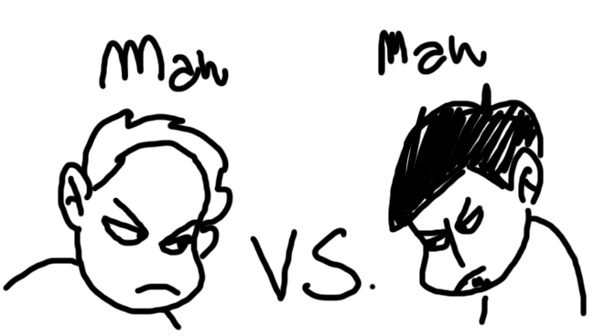

THERE ARE TWO MODES
1.Human Vs Human 2.Human Vs Computer

Slide 5
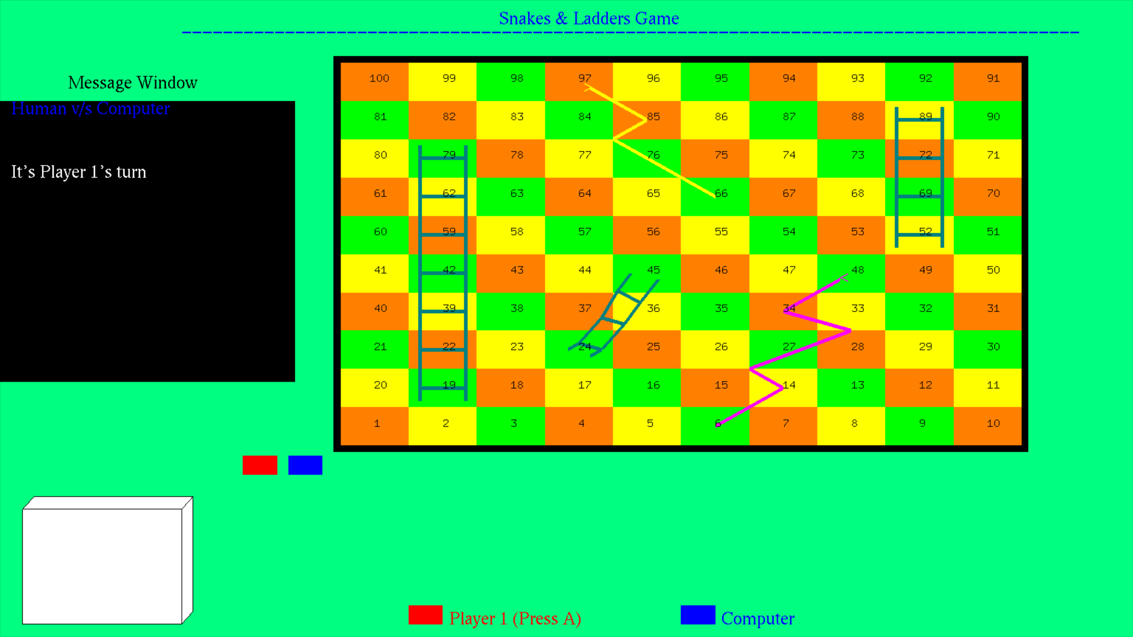

The game has two modes-
Human v/s Human mode
Human v/s Computer mode

Slide 6
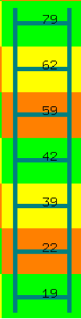
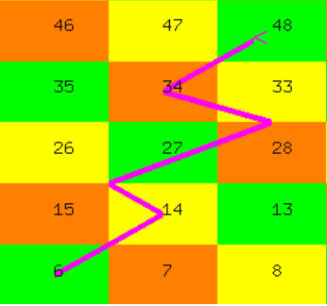
The Snake and Ladder is drawn using line segments and line loops with appropriate line width.
The Top and Bottom of Ladder is stored in a structure called Ladder.
Similarly, the Head and Tail of Snake is stored in structure called Snake.

Slide 7
User defined functions-
void init( ) //it is used to initialize the output window
void start_screen( ) //it is used to display the start screen
void print_text(int x,int y,char str[ ],float r,float g,float b) //used to display text
void frontscreen( ) //used to display front screen
void load_screen( ) // the Loading screen is displayed using this function
void display( ) //it is the function used to display the output which is called to display certain changes
void locpt_conv(int loc) //converts the block no. into its corresponding bottom-left co-ordinates

Slide 8
User defined functions (continued) -
void disp_fig( ) //displays player's coins
void dice() //used to display the no. of dots on dice based on random no. generated
void throw_dice( ) //used to generate no. and change the player position
void menu(int id) //used for displaying right mouse button menu
void mouse(int btn,int state,int x,int y) //its a mouse driven function which detects any mouse interaction
void keys( unsigned char key, int x, int y ) //a keyboard driven function that detects keyboard interaction

Slide 9
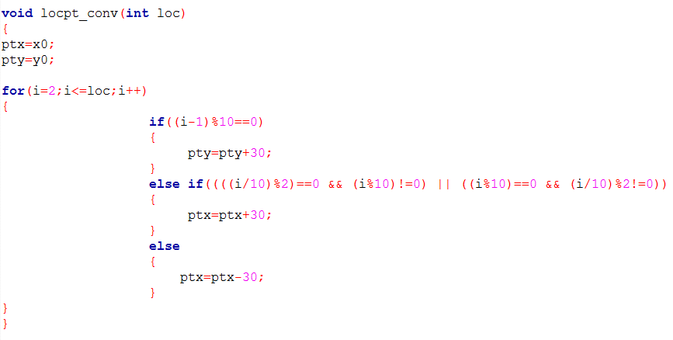
Location to point conversion function-
This function is responsible for the movement of the coins by finding the new co-ordinates on the board.
to change row by incrementing y-axis
Rightside movement
Leftside movement

Slide 10
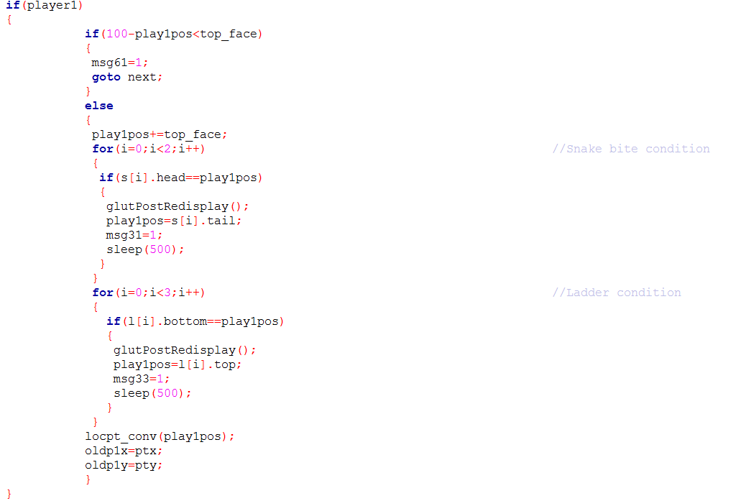
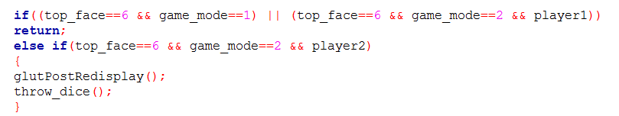

throw_dice function-
Generates a random no. and displays the corresponding dots on dice using dice function.
It also adds this no. to the player’s current position and then calls locpt_conv function to obtain co-ordinates to translate the coin using disp_fig function
Before translation it also checks for blocks requirement condition and then on updating the position checks for snake bite & ladder climb conditions and also condition of 6.

Slide 11
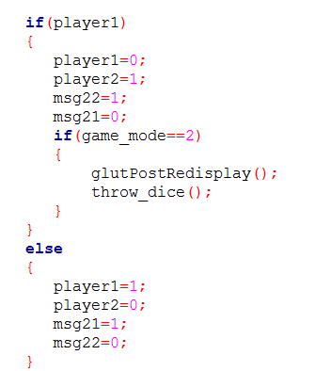
And then, if the game mode is 1 (i.e. Human v/s Human) or for player 1 in Human v/s Computer, the control is returned and waits till the player presses the appropriate key.
For computer, the throw_dice function is called without waiting for any key.

Slide 12

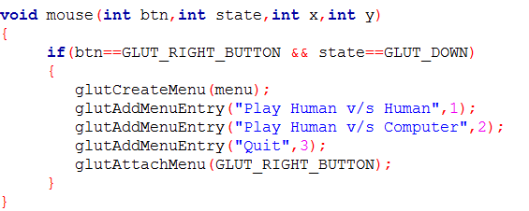
Menu-(with mouse )
The mouse function is used to create menu and invoking on pressing right mouse button.
menu function is used to handle the option selected by initializing certain parameters.

Slide 13

Keyboard function-
It is used to handle the events that occur on pressing certain keys.
Keys such as A/a and L/l are used for throwing dice during game.
ENTER key is used for transition between screens.
If wrong key is pressed then the invalid key message is generated.

Slide 14
Flowchart-
display( )
keys( )
throw_dice( )
locpt_conv( )
disp_fig( )
menu( )
At start
Rest of the times
Until finish==0
glutPostRedisplay( )

Slide 15
FUTURE ENHANCEMENT -
OpenGL project here which demonstrates the Snake & Ladder game can be further modified-
The cube present can be made 3D with on click rotation
A certain delay can be introduced to the transition between each block
The game can also be expanded with multi-player (from 3 to 6 players) capabilities

Slide 16
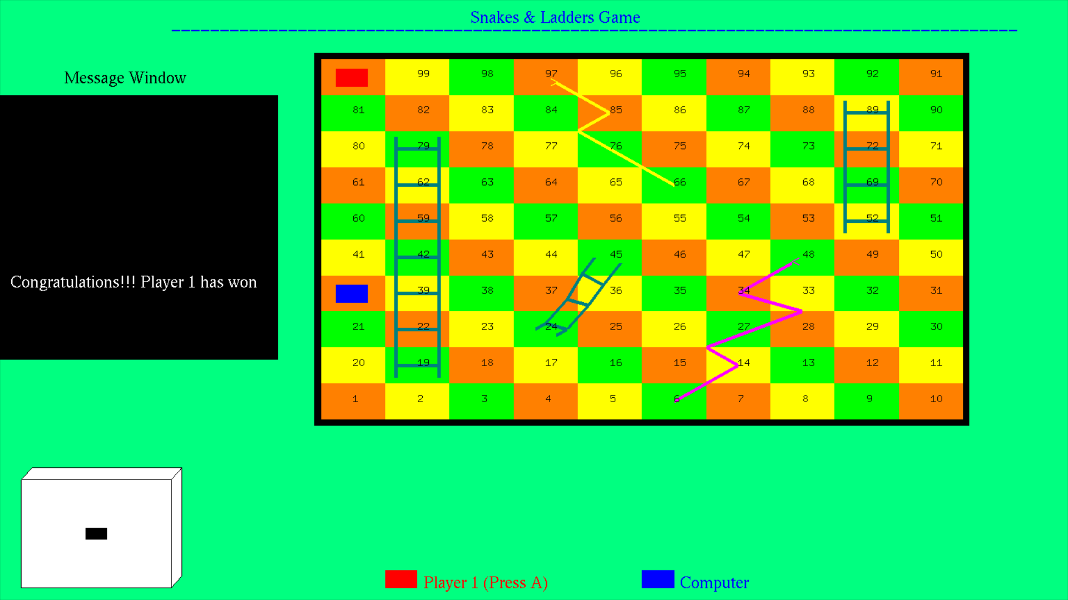
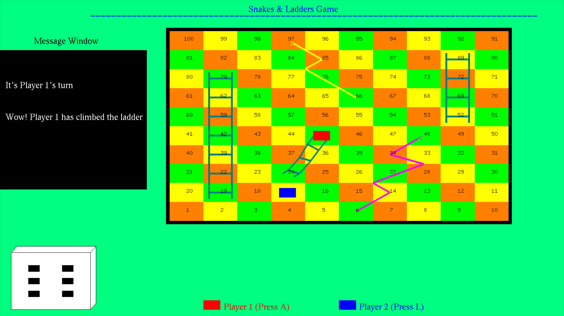
Snapshots-

Slide 17
Thank you…

